Slide 1
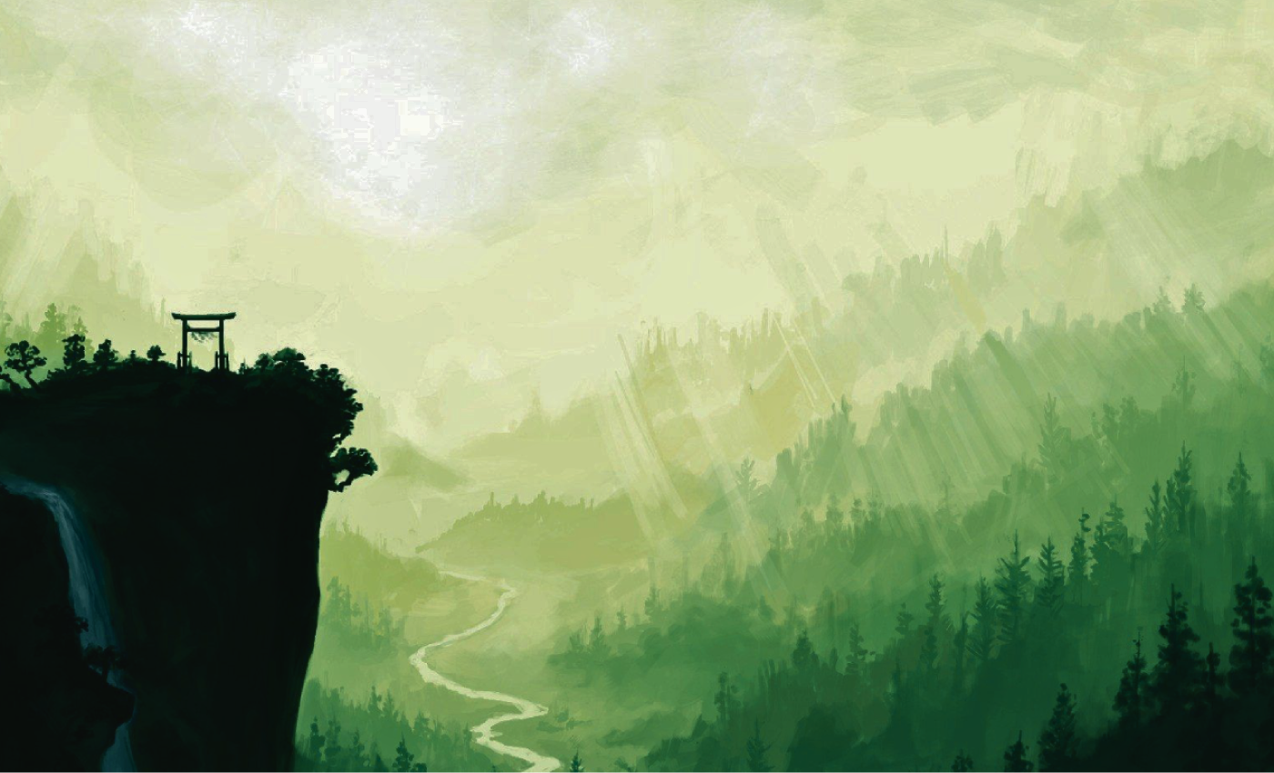
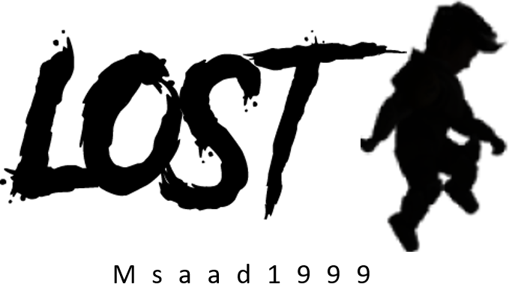

LET’S PLAY!

Slide 2


Submitted by:
A.Neeraja BL.EN.U4CSE22004
C.H.Mounika Begum BL.EN.U4CSE22014
K.Vigneswara Reddy BL.EN.U4CSE22030
R.Henry Koushal BL.EN.U4CSE22050

Slide 3








INTRODUCTION
In the shadow of towering mountains, a solitary figure awakens, shrouded in the biting embrace of wind and the echoes of an aching emptiness. The taste of hunger and the lingering sting of pain are companions to the pervasive sense of loss that envelops the waking consciousness. As the first light of dawn timidly pierces through the jagged peaks, the realization of a profound absence sets in—a vital piece of the protagonist's existence has been severed. Disoriented and alone in this rugged terrain, the quest for self-discovery and the retrieval of what was lost begins, unveiling a treacherous and emotionally charged journey through the unforgiving landscape of the unknown.

Slide 4


Objective
In "Lost Adventure" the primary objective is to guide the protagonist through a journey of self-discovery and redemption as they confront the profound sense of loss that envelops them. Players must navigate the treacherous mountainous terrain, solving puzzles, overcoming challenges, and interacting with spectral echoes to uncover the fragments of memories tied to their forgotten past. The ultimate goal is to reclaim what has been lost and bring closure to the protagonist's emotional turmoil

Slide 5

Motivation
The motivation to play "Lost Adventure" lies in the promise of a deeply emotional and transformative gaming experience. The inclusion of challenging and innovative puzzles adds an element of gameplay that motivates players to actively participate in the narrative. The desire to solve these puzzles and uncover the next piece of the story serves as a driving force. In summary, the motivation to play "Lost Adventure" is driven by the desire for a captivating narrative experience, emotional engagement, and the opportunity to actively shape the story through gameplay interactions.

Slide 6


Problem definition
Embark on a soul-searching journey through treacherous mountain terrain in the "Lost Adventure" game, as you grapple with hunger, wind, pain, and an unrelenting sense of loss, seeking to uncover the mysteries of a forgotten past.

Slide 7
Implementation details
The game's Menu class governs the user interface, offering options like play, exit, intro, guide, and credits. Projectiles and enemies are managed by the Projectile and Enemy classes, each exhibiting distinct behaviors. Graphics and images are loaded using ImageIO, with rendering orchestrated in the paint method. The execution flow unfolds with a captivating introduction, transitioning to the main menu on a space key press. Players can explore options like play, exit, or delve into additional context through the credits, intro, and guide states. Dependencies include the Java Swing framework and external images for sprites, backgrounds, and visual elements. To run the game, compile and execute the StartingClass Java class, navigating through the adventure using keyboard and mouse inputs as prompted on-screen.

Slide 8
Implementation details
The "Lost Game" is a 2D side-scrolling action adventure developed using the Java Swing framework. Its core components include a robust game loop managing states such as start, menu, game, credits, intro, guide, and dead. The main character, controlled by the Robot class, features smooth animations handled by the Animation class. Parallax scrolling backgrounds add depth, courtesy of the Background class, while the Tile class and the loadMap method facilitate the representation and loading of various tiles from text files

Slide 9
Conclusion
As the sun breaks the horizon, casting a warm glow on the mountain peaks, a sense of clarity washes over you. The journey through hunger, wind, pain, and loss was a test of resilience, a transformative experience that forged your character. In the first light of dawn, you realize that what you lost was not a tangible object, but a part of yourself—the burdens of the past that held you back. With the mountains as witnesses, you embrace the lessons learned and the strength gained. The sense of loss transforms into a newfound lightness, as you descend from the mountains with a heart unburdened, ready to face the future with a renewed sense of purpose

Slide 10
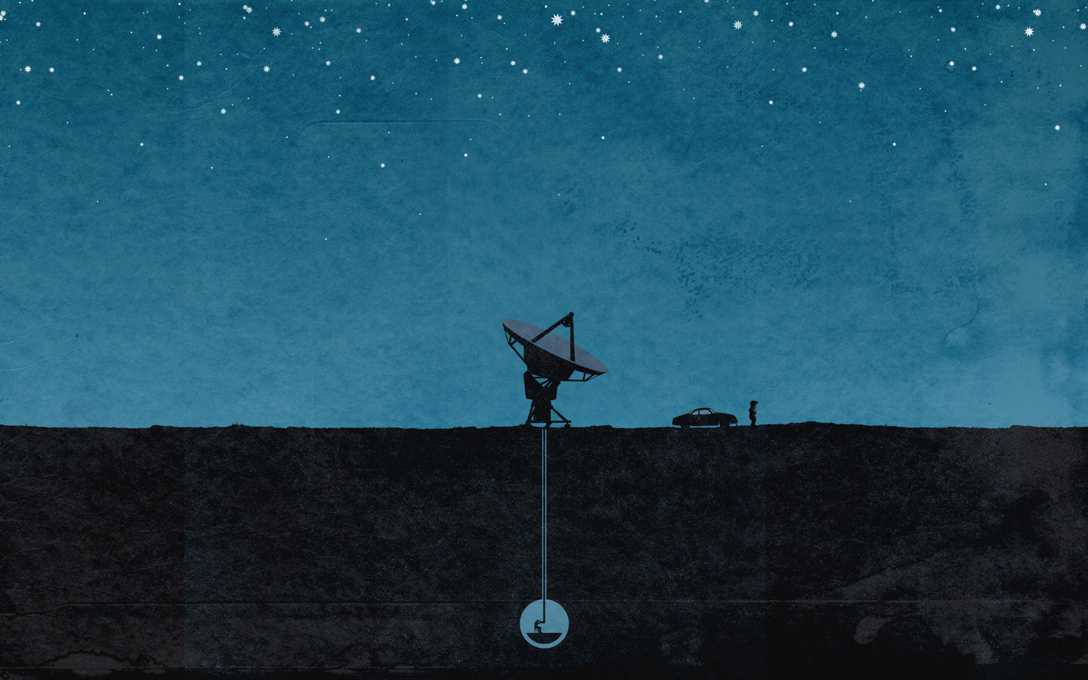
Thank you
You are lost

